Slide 1
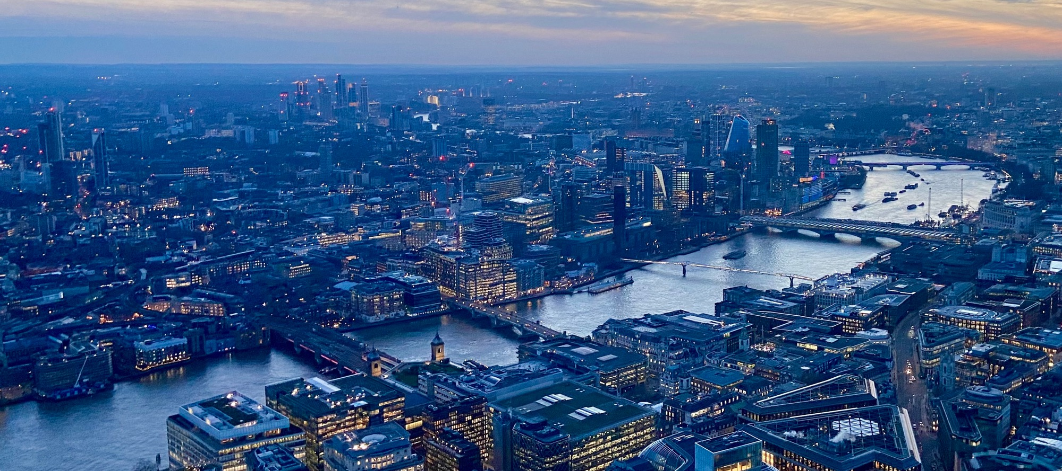
What can security consultants learn from how police solve problems?
Department of Security and Crime Science

Slide 2

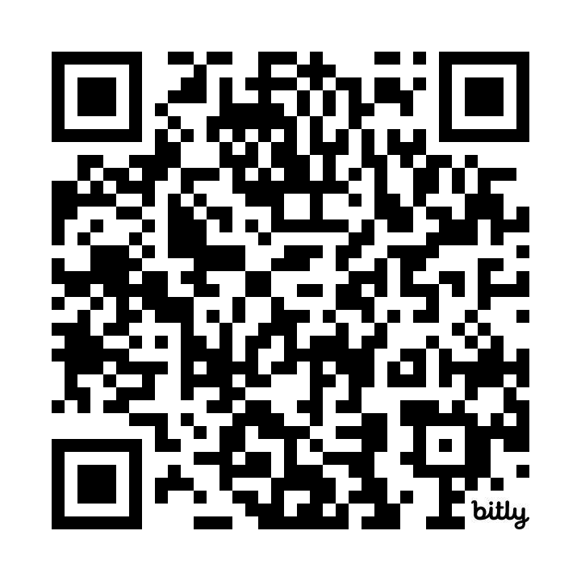

Slide 3
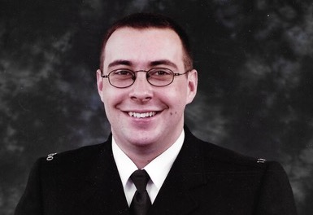
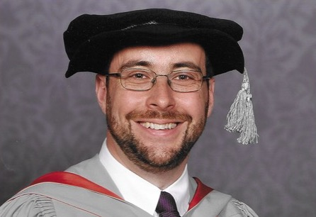
My career in two pictures

Slide 4
What is crime science?
traditional criminology
engineering
mathematics
law
history
Crime and security problems
psychology
political science
sociology
economics
computer sci.
geography

Slide 5
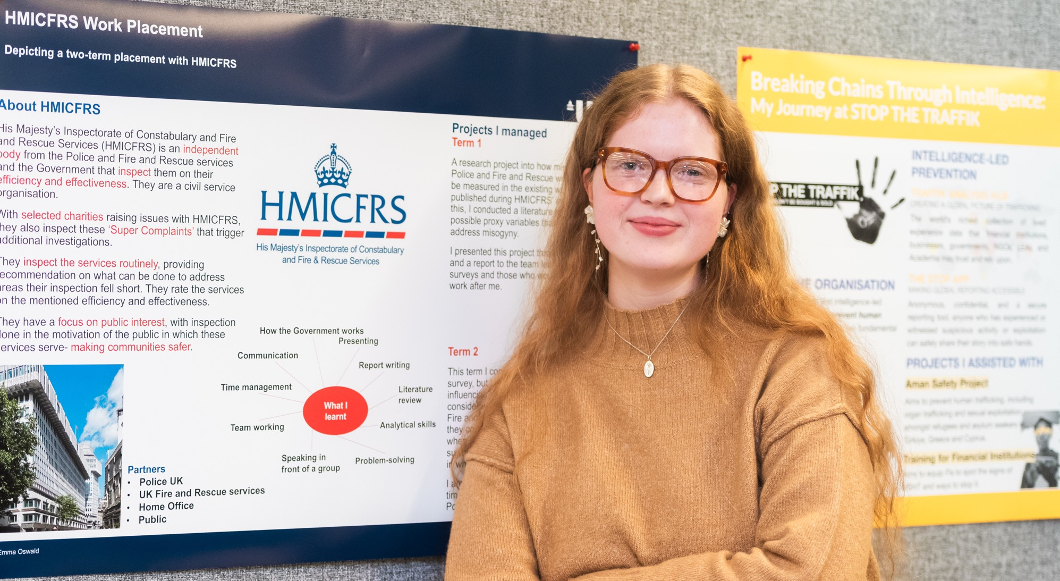

Slide 6
Problem solving
“the systematic identification of
repeat … recurring problems
that affect the community and …
produce heavy demands on police”
your client
Source: A Sidebottom. 2020. Successful police problem-solving: a practice guide. London: UCL Jill Dando Institute.

Slide 7
How police solve problems
Scanning: define the problem
Analysis: understand the problem in detail
Response: take action to solve the problem
Assessment: establish if the problem is solved

Slide 8
S
Use of cloned debit cards in local ATMs
A
Cards details are being obtained from cards at local gas stations by employees who owe money to a gang
R
Short term: covert observations to identify staff
Long term: work with gas-station owners to better secure payment terminals against fraud by staff
A
Monitor number of crimes being reported to banks or police

Slide 9
“[problem solving] produced a larger overall [reduction in crime] … twice the size of the increased traditional policing”
Source: A Braga, A Papachristos & D Hureau. 2014. The Effects of Hot Spots Policing on Crime. Justice Quarterly 31(4):633–663.

Slide 10
1
Be specific

Slide 11
The more specific the problem, the easier it will be to solve

Slide 12
Robbery
Commercial robbery
Personal robbery
Liquor-store robbery
Cash-in-transit robbery
…
Home invasion
Car-jacking
Phone robbery
…
Outside metro stations
Outside schools
Late at night
…

Slide 13
2
Seriously, be much more specific

Slide 14
Phone robberies outside nightclubs
Phone robberies outside a specific nightclub just after closing time
Phone robberies within 200m of a specific nightclub just after closing time by offenders from a local housing project riding dirt bikes

Slide 15
3
Make (a little) time for analysis

Slide 16
How police solve problems
Scanning: define the problem
Analysis: understand the problem in detail
Response: take action to solve the problem
Assessment: establish if the problem is solved

Slide 17
In what way is the problem most concentrated?

Slide 18
offenders
targets
places

Slide 19
Repeat offending
Journey to crime
Facilitators
Social networks
Intelligence interviews
Repeat victimization
Near-repeat victimization
Victim–offender overlap
offenders
targets
Hotspots
Place managers
places

Slide 20
At which point in the problem is it easiest to intervene?

Slide 21
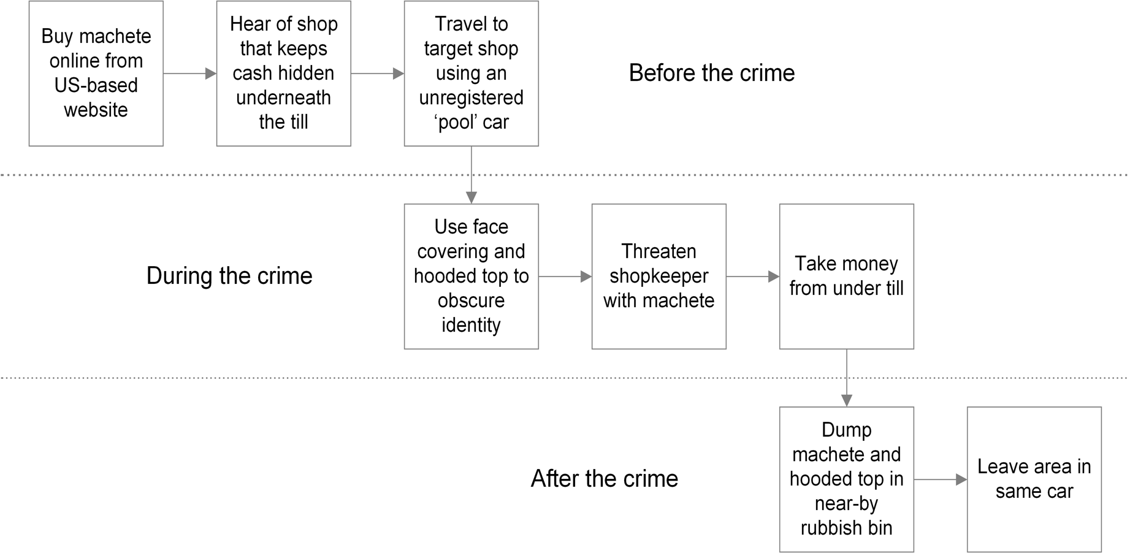

Slide 22
4
Use existing evidence

Slide 23
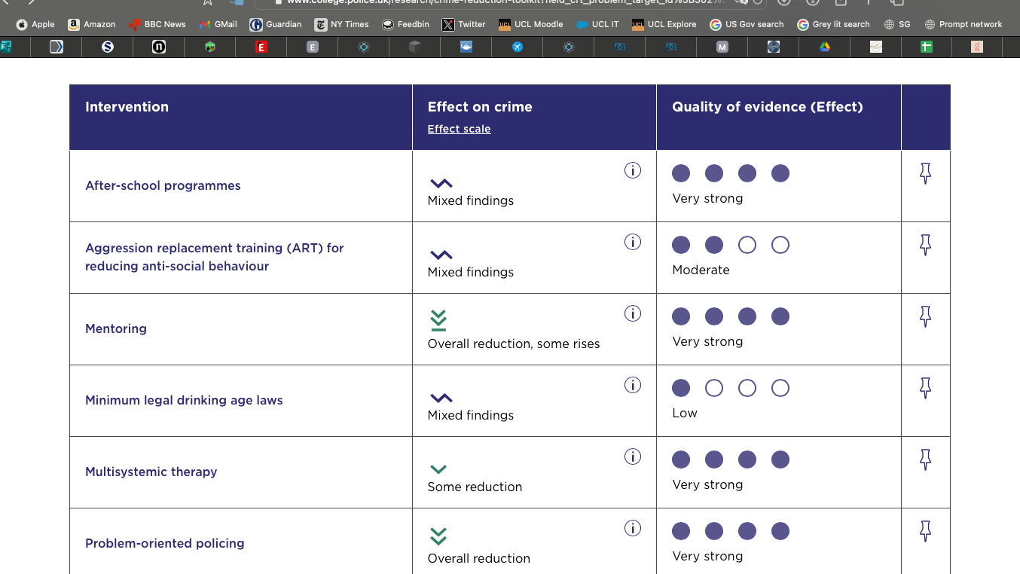
College of Policing Crime Reduction Toolkit

Slide 24
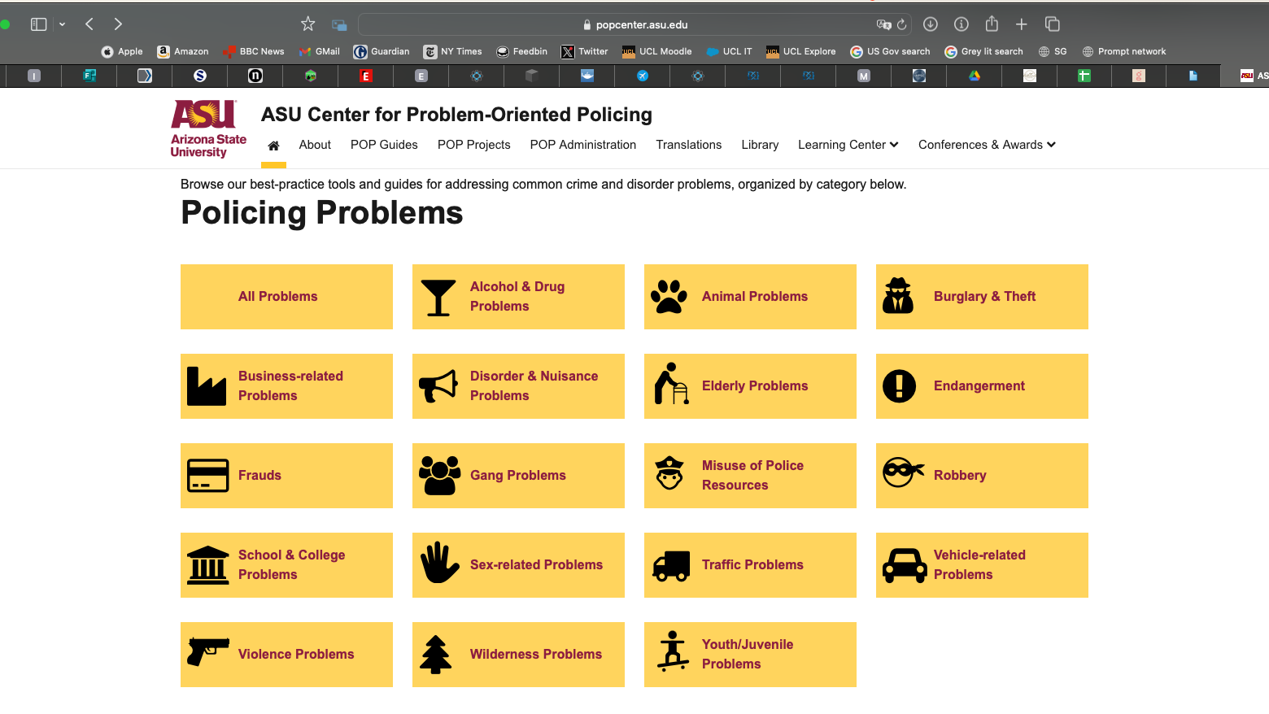
Arizona State University Center for Problem-Oriented Policing

Slide 25
5
Make use of practical psychology

Slide 26
The easier something is to do, the more people will do it

Slide 27
People prioritise short-term outcomes over long-term ones

Slide 28
Most people are bad at intuitively estimating risk

Slide 29

Practical Psychology for Policing by Prof Jason Roach

Slide 30
6
Changing environments works better than trying to change people

Slide 31
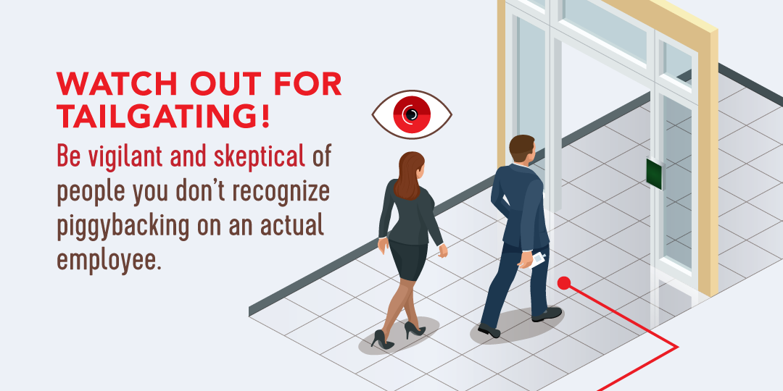
Image: ISC Events

Slide 32
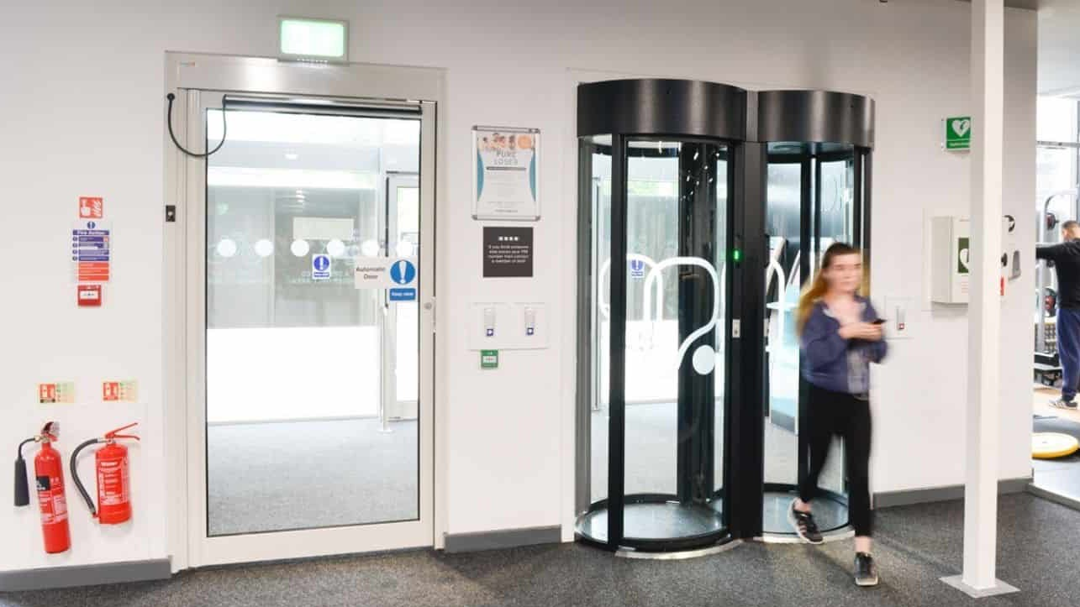
Image: Meesons

Slide 33
7
Have a short-term and a long-term response

Slide 34
Priority: rapid implementation
scanning
short-term response
analysis
response
long-term response
Priority: sustainability

Slide 35
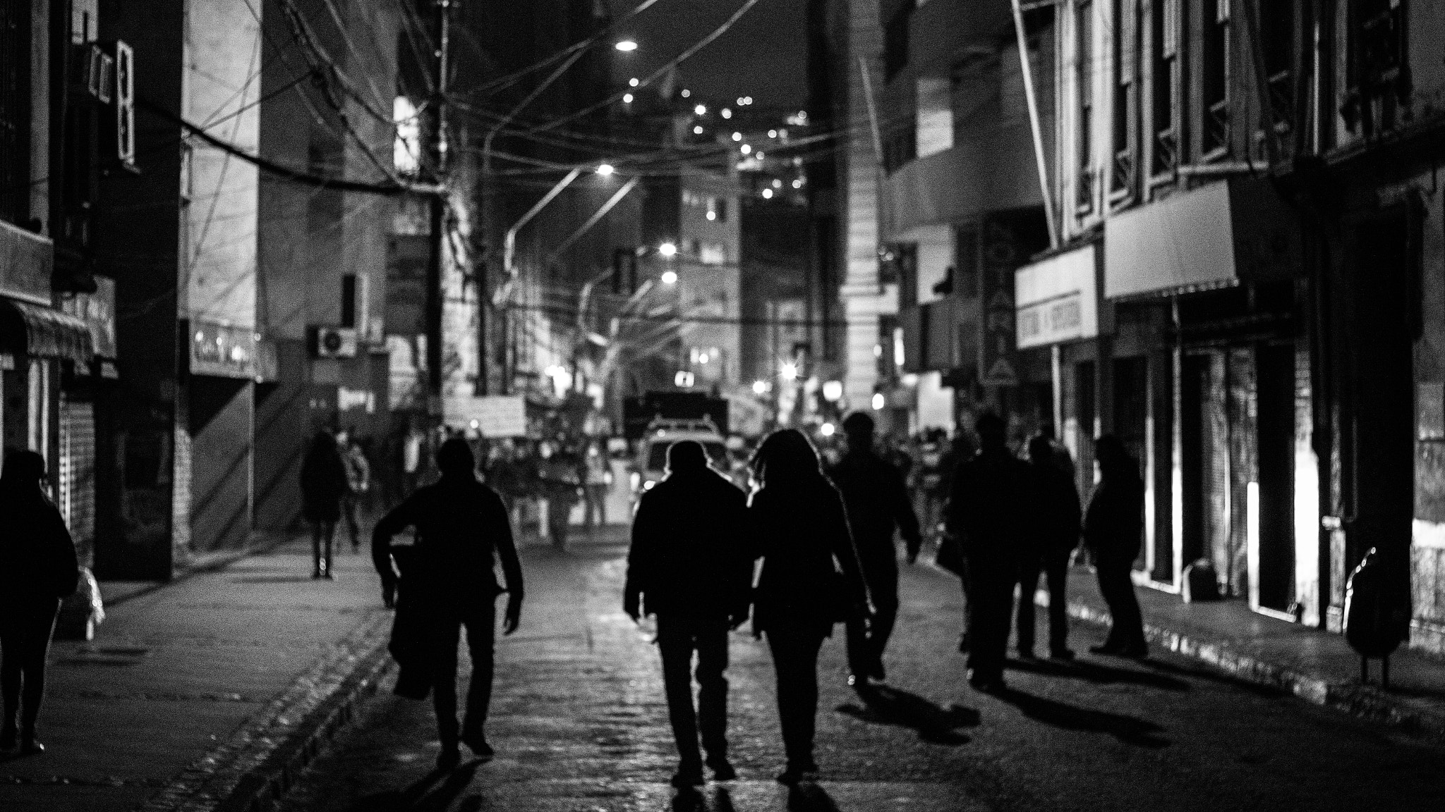
Image: Omar Burgos Dättwyler

Slide 36
8
Ask yourself: what has to happen for my plan to work?

Slide 37
Action
Mechanism
Effect
Liquor store moves expensive whisky behind register
Shoplifters cannot reach expensive whisky
Less expensive whisky is stolen

Slide 38
Action
Mechanism
Effect
Surveillance cameras
?
Less expensive whisky is stolen

Slide 39
9
Ask yourself: what might stop my plan from working?

Slide 40
Liquor store moves expensive whisky behind register
Shoplifters cannot reach expensive whisky
Less expensive whisky is stolen

Slide 41
10
Measure achievement, not just activity

Slide 42
★☆☆☆☆
3 days of action
★★☆☆☆
5 people prosecuted
★★★★☆
50% reduction in crime

Slide 43

Slides + links
lesscrime.info/talk/iapsc-problem-solving
Get in touch matthew.ashby@ucl.ac.uk
@lesscrime

